Slide 1


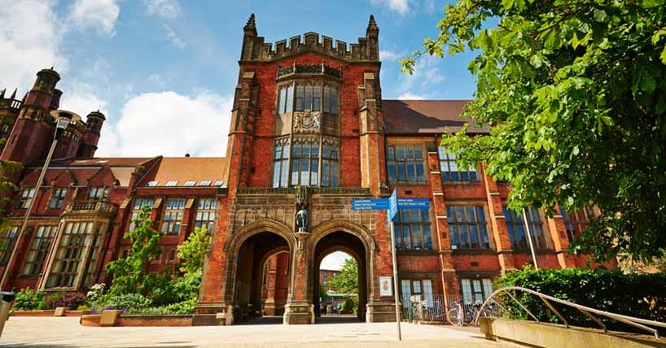
From Newcastle. For the world.
Rural Energy Opportunities and Challenges
Professor Phil Taylor
Director, EPSRC National Centre for Energy Systems Integration
Supergen Energy Networks Hub Lead
Siemens Professor of Energy Systems

Slide 2




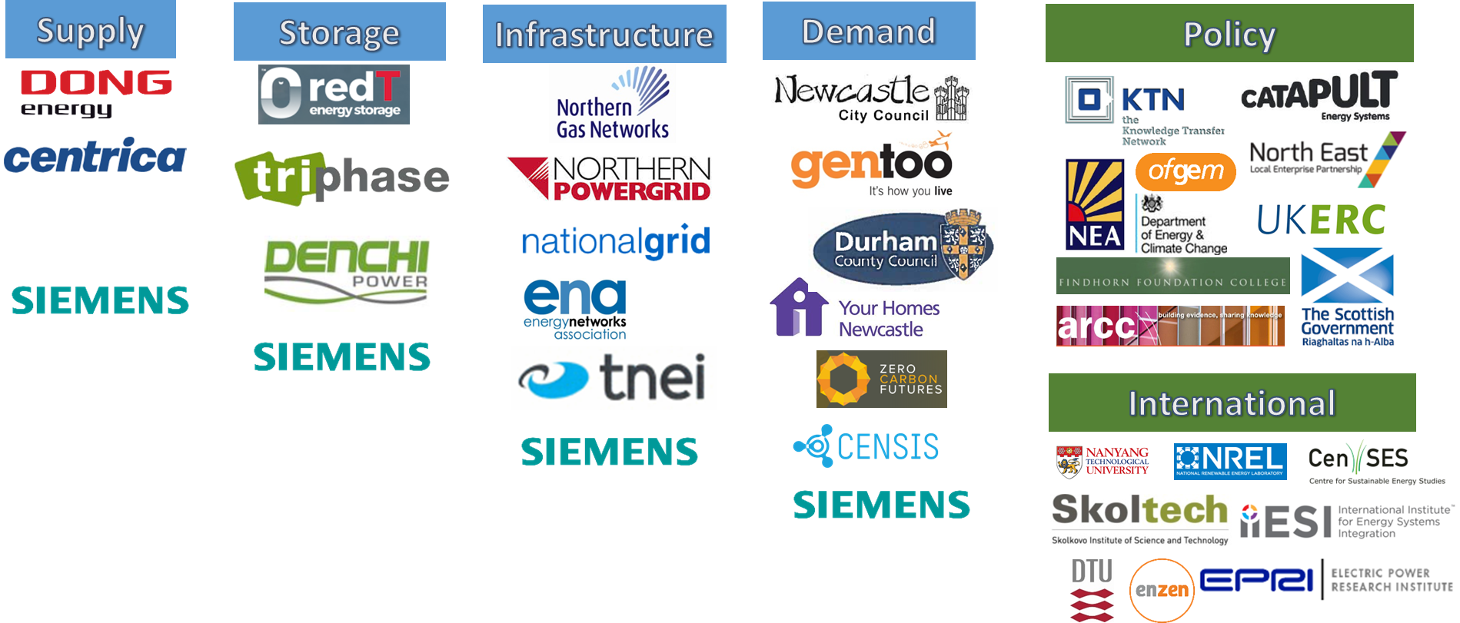









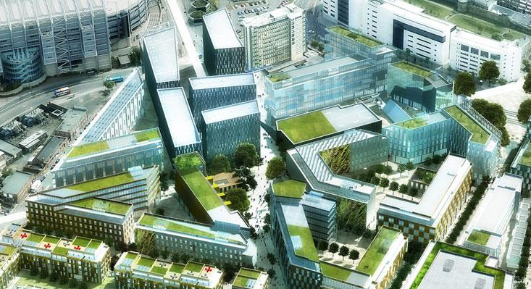
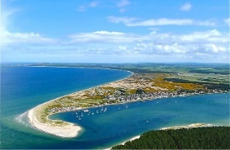
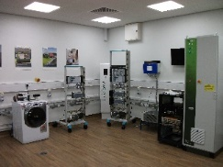

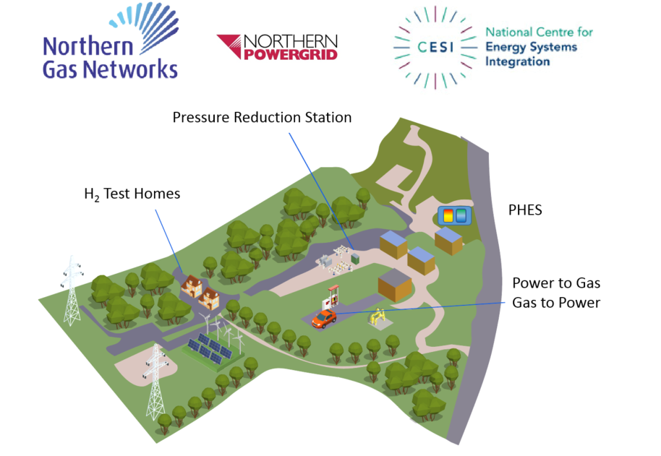
EPSRC National Centre for Energy Systems Integration
£20M multi-disciplinary research centre investigating the Whole Energy System
Multi-vector energy systems analysis utilising Big Data and Supercomputer techniques and technology
Funded by EPSRC, a consortium of 5 research intensive universities, Siemens and other industry partners
Address current limitations:
Uncertainty, Calibration, Behavioural dynamics, Spatial and Temporal variations, Representing interdependencies
Addressed by:
Co-evolutionary approach to supply and demand, Stochastic Programming, Agents, System of Systems, Fine Grain Data, Quantitative and Qualitative, Expert Judgement, Multi-Disciplinarity, soft linking between models, High Performance Computing Framework,
Some of our strategic industrial and governmental partners
Some of our living labs and demonstrator facilities for research and validation
Newcastle helix
Findhorn Community
Siemens Smartgrid Lab
Thames Valley Vision
Integrel – Utility Scale Gas and Electricity Distribution Laboratory
Cockle Park Farm

Slide 3
Rural Energy Challenges and Opportunities
1 billion in the world no access to electricity, 47% World’s Population live in rural villages, 80% Worlds population in cities by 2050 ?
Space
Natural Resources
Weak Infrastructure
Interaction with Urban Areas
Devolution

Slide 4
Rural Energy Challenges and Opportunities
Energy Underpinning Rural Enterprise
Low Carbon Opportunities versus Fossil Fuels
Protect Natural Environment
Internet Access
Smart Grids, Data, Cloud, Storage
Off Grid Solutions – Grid Extensions often take 10 years plus
Community Owned Energy Systems – Skills
Low Carbon Vehicles Mobility meets Energy

Slide 5
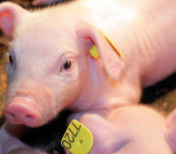
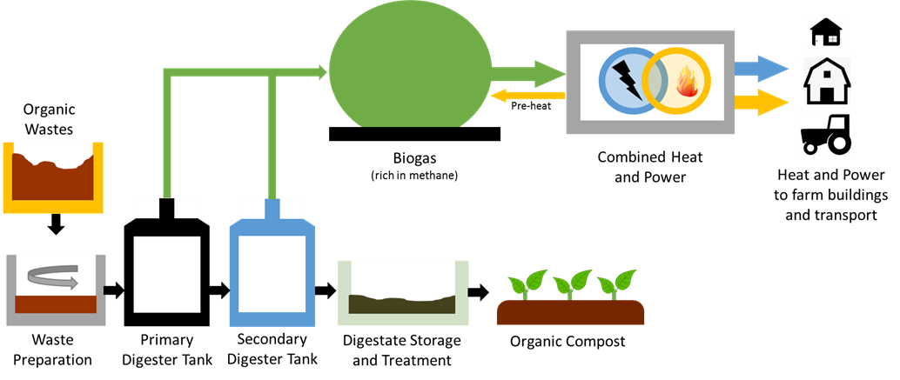
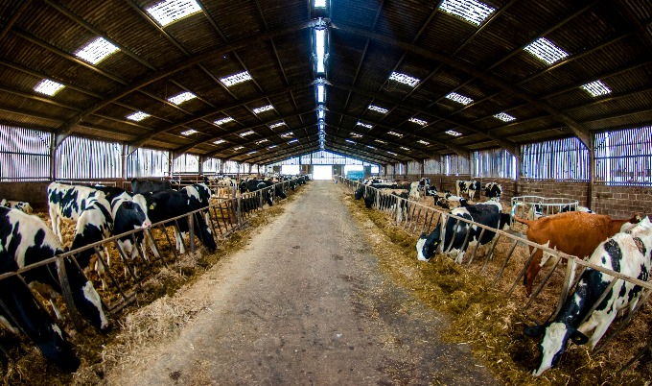
Cockle Park Farm
Cockle Park Farm is a working 307 hectare mixed farm situated near Morpeth. The farm is owned and operated by Newcastle University
it provides a living laboratory for us to trial innovative rural technologies and experiment on the system
Combined farm waste fuelled AD with CHP system installed and operational

Slide 6
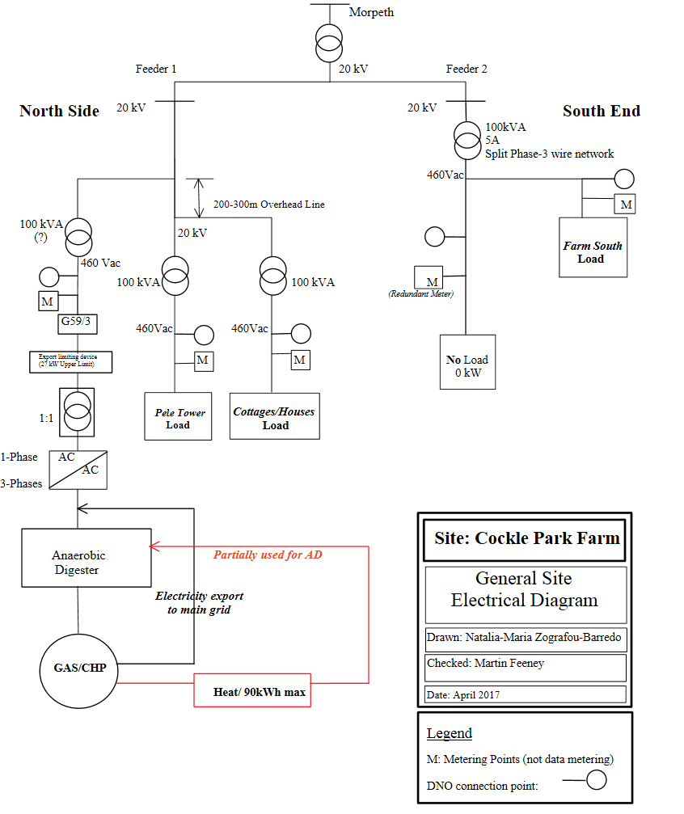
Grid Connection

Slide 7
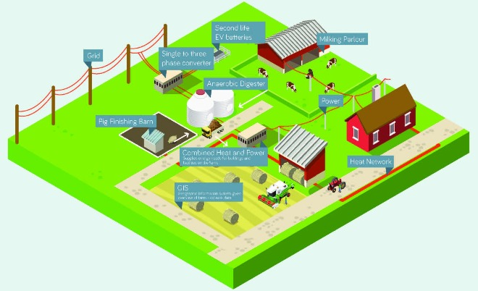
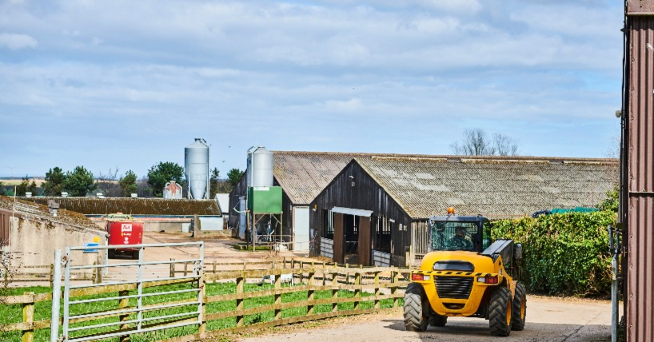
Cockle Park Farm

